Slide 1
Chemical Kinetics:
Clearing the Air
(OpenStax 17 (Gilbert Chapter 13)

Slide 2
Examining How/Why Reactions Happen
Thermodynamics
Do we have enough energy for the reaction to occur? Is ∆S_{univ} (or ∆G) favorable?
Chapter 12
Kinetics
At what rate is the reaction going to occur?
Chapter O.S. 17 Gilbert 13
Equilibrium
How much product is going to be formed?
Chapter 14 & 15

Slide 3
Chemical Kinetics
Chemical Kinetics:
Study of rate of change of concentrations of substances involved in chemical reactions
Reaction Rate:
How rapidly a reaction occurs; related to rates of change in concentration of reactants and products over time
Factors Affecting Reaction Rates:
Physical state of reactants; concentration of reactants; temperature; presence of a catalyst

Slide 4
Reaction Rates
Relative rates of consumption of reactants and formation of products based on stoichiometry
a A + b B → c C + d D
molar reaction coefficients
General Reaction Rate
∆t = change in time
∆[ ] = change in molar concentration
The reported rate can’t depend on which change we measure
Must have a method of expressing a change in product to as change in reactant, etc.
Rates are expressed as positive numbers

Slide 5
Reaction Rates
Relative rates of consumption of reactants and formation of products based on stoichiometry
a A + b B → c C + d D
molar reaction coefficients
General Reaction Rate
∆t = change in time
∆[ ] = change in molar concentration
Sign conventions:
∆[A]/∆t is a negative number,
Minus sign makes rate positive
∆[C]/∆t is positive
Gives a positive rate without the minus sign

Slide 6
Reaction Rates
N₂(g) + O₂(g) → 2 NO(g)
Divide by coefficients to make reaction rates constant (always positive)
An expression relating the rate of reaction to each of the reactants and products.

Slide 7
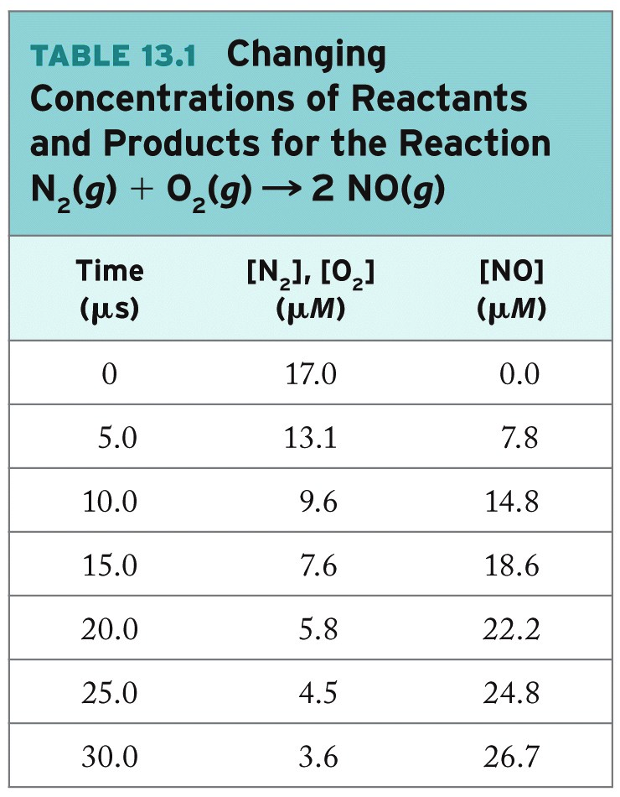
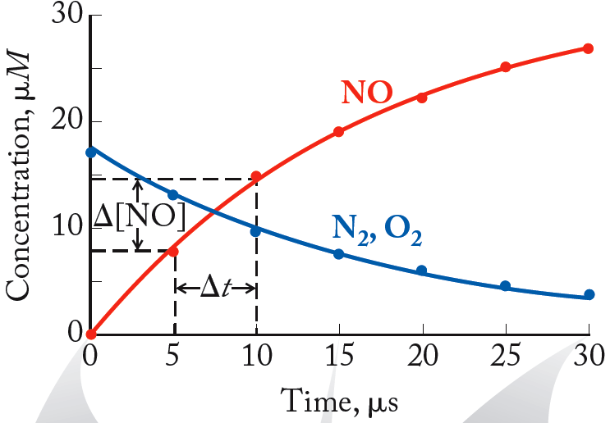
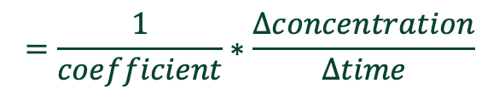
Average Rate
$$=\frac{1}{coefficient}∗\frac{∆concentration}{∆time}$$
Average Rate: Change in concentration of reactant or product over a specific time interval
N₂(g) + O₂(g) → 2 NO(g)

Slide 8
Reaction Rates
N₂(g) + O₂(g) → 2 NO(g)
Relative Rates:
Actual Rates:

Slide 9
Example: Average Reaction Rates
Calculate the relative and average reaction rate for the time period between 15 μs and 30 μs using the data below:
N₂(g) + O₂(g) → 2 NO(g)
Time (μs) | [N₂], [O₂] (μM) | [NO] (μM)
0 | 17.0 | 0.0
15 | 7.6 | 18.6
30 | 3.6 | 26.7
T_{f} = 30 μs; T_{i} = 15 μs

Slide 10
Example: Relative Reaction Rates
The relative rates should be the same if expressions are correct.

Slide 11
Example: Actual Reaction Rates
N₂(g) + O₂(g) → 2 NO(g)
The actual rates can be calculated directly from measured data.
Rate of reaction
Rate of reaction generally reported using a species with coefficient ‘1’ and with a positive number

Slide 12
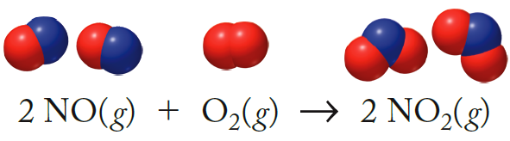
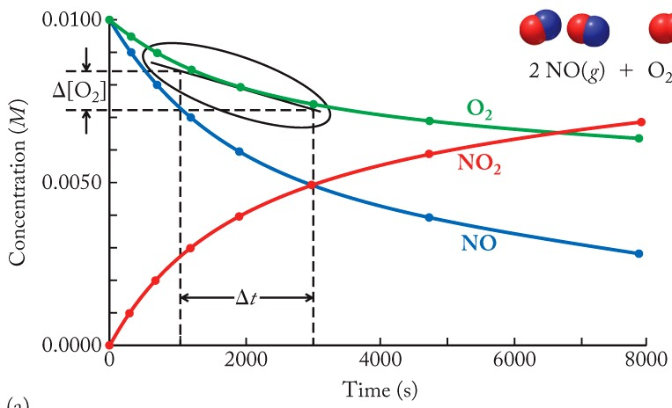
Instantaneous Reaction Rates
Instantaneous Rate:
Reaction rate at a particular instant
Determined graphically as tangential slope of concentration vs. time plot

Slide 13
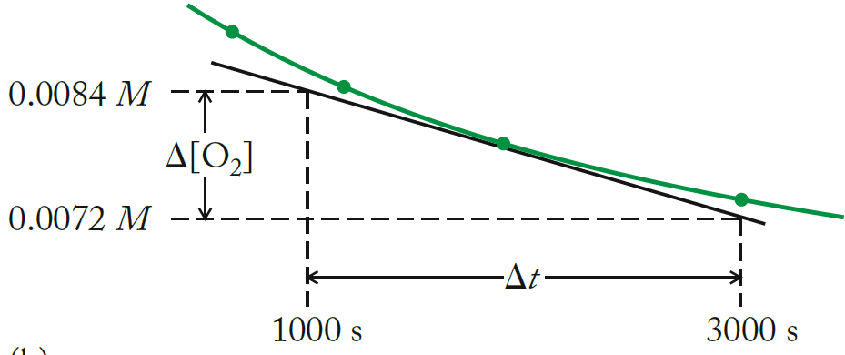
Instantaneous Reaction Rates
Average reaction rate equation but with the tangent line
2 NO(g) + O₂(g) → 2 NO₂(g)
Notice that these values are coming from the tangent line, not the drawn-in curve.

Slide 14
Review: Reaction Rates
Related Reaction Rates:
Uses coefficients from chemical equation
Different relationships relating the concentration change of each species to the overall rate
Actual Reaction Rate
Measured experimentally, either average or instantaneous
a A + b B → c C + d D

Slide 15
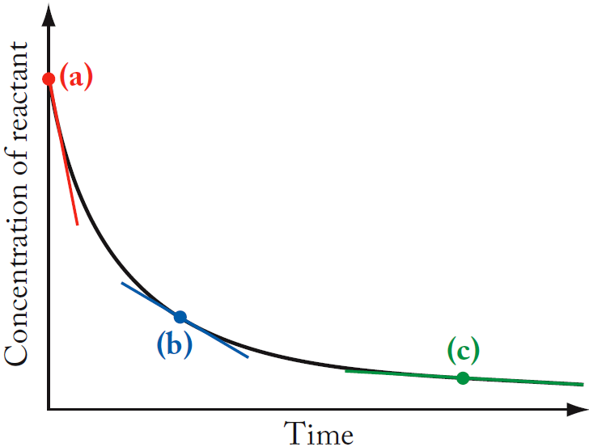
Initial Reaction Rates
Initial Rate: Rate of a reaction at t = 0, immediately after the reactants are mixed
(a) Initial rate
(b), (c) Instantaneous rates
Useful because at t = 0, the concentration of products is zero.

Slide 16
Reaction Order
Reaction Order:
Experimentally determined number defining the dependence of the reaction rate on the concentration of a reactant
Rate Law:
Equation that defines the experimentally determined relationship between reactant concentrations and the rate of the reaction
Overall Order of Reaction:
Sum of exponents for the concentration terms in the rate law

Slide 17
Review Rates
Rate: What’s measured – change in concentration with time.
Rate Law: How that rate changes with variables. Rate = k [A]^{m} [B]^{n}
k = rate constant
m and n are the reaction orders with respect to reactants A and B
(m + n) = overall order
m and n are unrelated to the balanced reaction coefficients!!

Slide 18
Review Rates
Next week in Lab:
Measured as slope from data for each run
Initial concentration changed for each run.
Why no [I₂]^{p}?
The coefficient is assumed to be zero
FYI: next week’s PWS is non trivial and can’t just be looked up

Slide 19
Review: Rate Law and Rate Constant
Rate Constant (k):
Proportionality constant that relates the rate of a reaction to the concentration of reactants
Example: A + B → C
Rate Law: Rate = k [A]^{m} [B]^{n}
k = rate constant
m and n are the reaction orders with respect to reactants A and B
(m + n) = overall order
m and n are unrelated to the balanced reaction coefficients!!

Slide 20
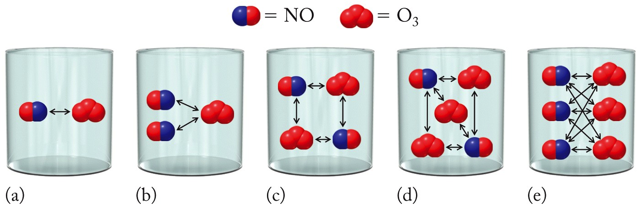
Effects of Concentration on Reaction Rates
NO(g) + O₃(g) → NO₂(g) + O₂(g)
Rate = k[NO][O₃]
m =1; n =1
[O₃] held constant
[NO] doubled
[O₃] doubled
[NO] held constant
Increasing concentrations increases collisions between reactants, leading to formation of products.

Slide 21
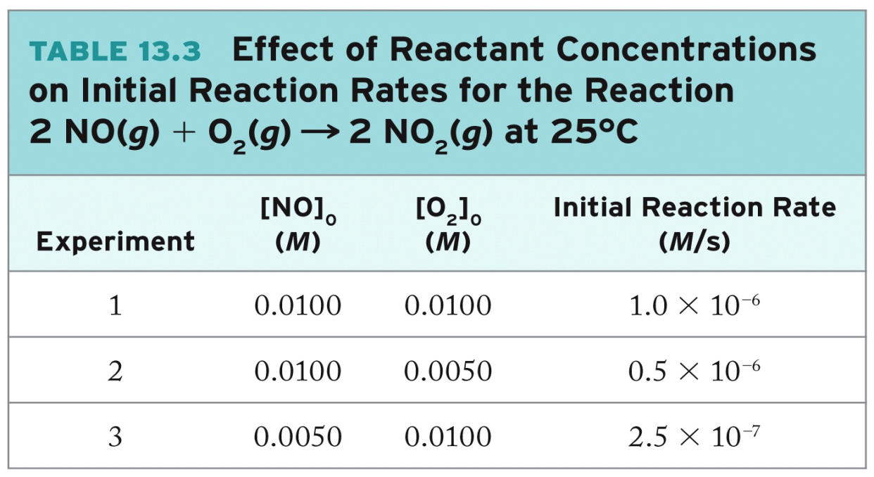
Determination of Rate Laws
2NO(g) + O₂(g) → 2 NO₂(g)
Rate = k[O₂]^{n}[NO]^{m}
Determine values of n, m by measuring initial rate under different conditions

Slide 22
Determination of Rate Laws
Rate = k[O₂]^{n}[NO]^{m}
Step 1: Find n:
Compare experiments where only [O₂] is changing.
Experiments 1 and 2
[NO] is held constant.
[O₂] is halved.
Rate is halved
(Therefore, Rate ∝ [O₂]^{n})
[O₂] and Rate have a direct/linear relationship (first order).
n = 1
Notes:
When NO is held constant and O2 is halved, the rate is halved so the order of O2 is 1

Slide 23
Determination of Rate Laws
Rate = k[O₂]^{n}[NO]^{m}
Step 2: Find m:
Compare experiments where only [NO] is changing.
Experiments 1 and 3
[O₂] is held constant.
[NO] is divided by 2.
Rate is divided by 4.
(Therefore, Rate ∝ [NO]^{m})
[NO] and Rate have a “squared” relationship (second order).
m = 2
Notes:
O2 is held constant while NO was halved, the reaction rate went down by 4, so the rate is 2
(if it went down by a factor of 9, the rate would be 3)

Slide 24
Overall Rate Law & Order
2NO(g) + O₂(g) → 2 NO₂(g)
Rate = k[O₂]^{n}[NO]^{m}
n = 1
m = 2
Rate = k[O₂] [NO]²
Overall reaction order: the sum of the exponents of the concentration terms in the rate law
reaction order = n + m
= 1 + 2 = 3
a “third” order reaction

Slide 25
Comments on Rate Constant (k)
k can be calculated from the rate law using data from any experiment (In lab we average 5-6 runs)
k is specific to a particular reaction, at a certain temperature
The units for k depend upon the rate expression
temperature effects rates of reaction!
have to pay attention to units…they won’t magically work out to the same thing each time.
Notes:
The unit for rate will be concentration/time
k will have any unit it needs to cancel everything it needs to get the units to be (concentration of thing being measured)/time

Slide 26
Calculation of Rate Constant (k)
2NO(g) + O₂(g) → 2 NO₂(g)
Rate = k[O₂] [NO]²
(at 25 °C)
k can be calculated from the rate law using data for any experiment
Using data from Experiment 1,

Slide 27
Calculating Non-Obvious m, n Values
Choose any two appropriate experimental data sets for determination of m or n. Use log properties to solve.
For an arbitrary species X, rate law expressions may be written:
Experiment #1
Experiment #2
Combine two equations by setting up a proportion
equivalent to
To solve for m, take log of both sides
Use a property of logs
Notes:
We will plot log-log graphs because log of rate (y) = m*log of concentration (x)

Slide 28
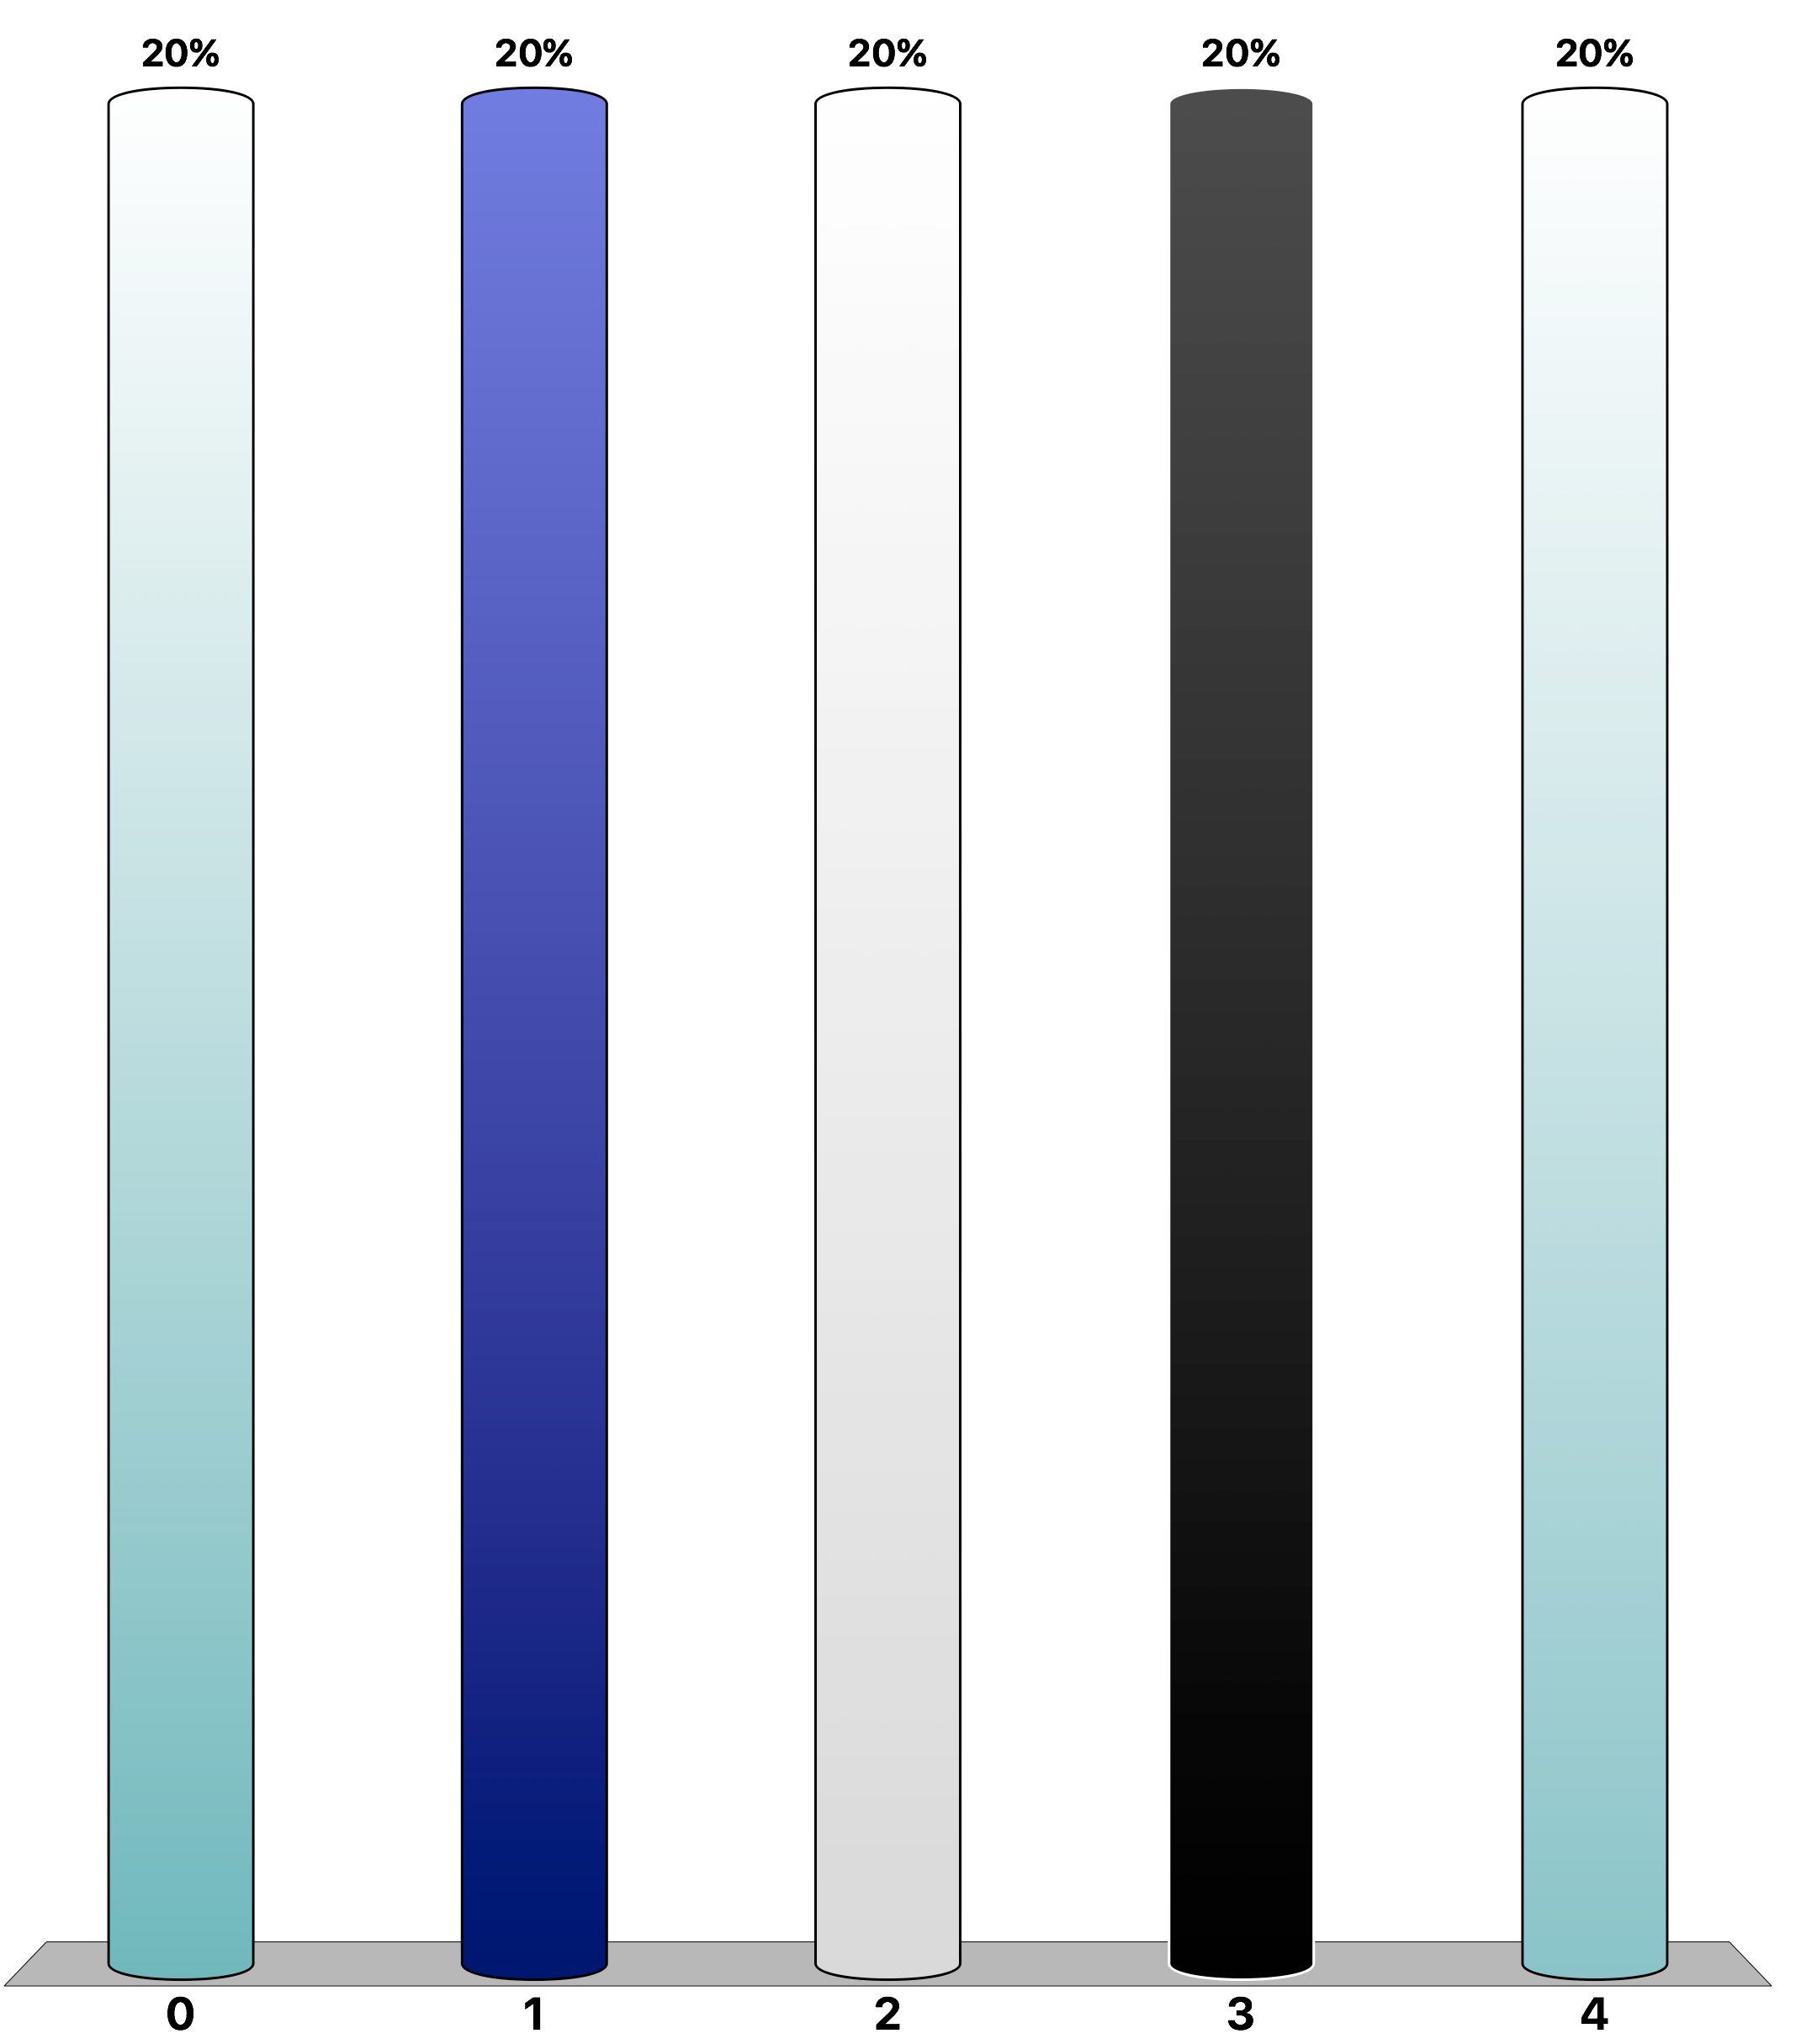


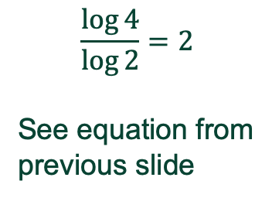

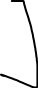

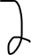
Write the rate law and calculate the rate constant k for the reaction given, using the following data: 2NO + 2H₂ → N₂ + 2H₂O
TopHat: Rate Laws/Rate Constants
Trial | [NO], M | [H₂], M | Initial Rate, M/s
1 | 0.00570 | 0.140 | 7.01×10⁻⁵
2 | 0.00570 | 0.280 | 1.40×10⁻⁴
3 | 0.0114 | 0.140 | 2.81×10⁻⁴
$$\frac{\log{4}}{\log{2}}=2$$
See equation from
previous slide
What is the overall reaction order for this reaction? Clicker next slide
Notes:
H2 order 1 b/c rate doubled when concentration of H2 doubled but NO stayed constant
NO order 2 b/c rate x4 when concentration of NO doubled but H2 stayed constant

Slide 29


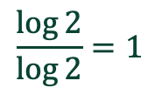


Write the rate law and calculate the rate constant k for the reaction given, using the following data: 2NO + 2H₂ → N₂ + 2H₂O
TopHat: Rate Laws/Rate Constants
Trial | [NO], M | [H₂], M | Initial Rate, M/s
1 | 0.00570 | 0.140 | 7.01×10⁻⁵
2 | 0.00570 | 0.280 | 1.40×10⁻⁴
3 | 0.0114 | 0.140 | 2.81×10⁻⁴
$$\frac{\log{2}}{\log{2}}=1$$
What is the overall reaction order for this reaction? Clicker next slide
Notes:
H2 order 1 b/c rate doubled when concentration of H2 doubled but NO stayed constant
NO order 2 b/c rate x4 when concentration of NO doubled but H2 stayed constant

Slide 30
Example: Rate Laws/Rate Constants Solution
2NO + 2H₂ → N₂ + 2H₂O
Trial | [NO], M | [H₂], M | Initial Rate, M/s
1 | 0.00570 | 0.140 | 7.01×10⁻⁵
2 | 0.00570 | 0.280 | 1.40×10⁻⁴
3 | 0.0114 | 0.140 | 2.81×10⁻⁴
Rate = k[NO]^{m} [H₂]^{n}
Rate = k[NO]² [H₂]
For Trial 1 & 2
[NO] is held constant (implies Rate ∝ [H₂]^{n})
[H₂] is doubled (×2).
Rate is doubled (×2).
first order
n = 1
overall rate order = 3
For Trial 1 & 3
[H₂] is held constant (implies Rate ∝ [NO]^{m})
[NO] is doubled (×2).
Rate is quadrupled (×4).
second order
m = 2

Slide 31
Example: Rate Laws/Rate Constants
2NO + 2H₂ → N₂ + 2H₂O
Trial | [NO], M | [H₂], M | Initial Rate, M/s
1 | 0.00570 | 0.140 | 7.01×10⁻⁵
2 | 0.00570 | 0.280 | 1.40×10⁻⁴
3 | 0.0114 | 0.140 | 2.81×10⁻⁴
Rate = k[NO]² [H₂]
Calculate k:
Using data from Experiment 1,
Notes:
Remember that k has different units depending on the equation

Slide 32
Integrated Rate Law:
Mathematical expression describing the change in concentration of a reactant with time
Rate is the slope.
If we “integrate” it, we get the original function or curve. Calculus helps here but is not required.
Simple example:
y = mx + b or [A] = -k(t) + [A₀]
The “derivative” or rate ask what is the slope?
Clearly for the first one the slope is m meaning “rise over run” ∆y/∆x = m
For the second one the slope is –k meaning ∆[A]/∆t = –k
“Integrated Rate law” means going from slope to equation

Slide 33
Integrated Rate Law: what do we mean?
Integrated Rate Law:
Mathematical expression describing the change in concentration of a reactant with time
Example:
O₃(g) → O₂(g) + O(g)
(Experimentally determined)
Rate law:
Can write an integrated rate law which relates concentration to time
First Order Integrated Rate Law
Integrated Rate law:
Calculus is utilized to derive this expression

Slide 34
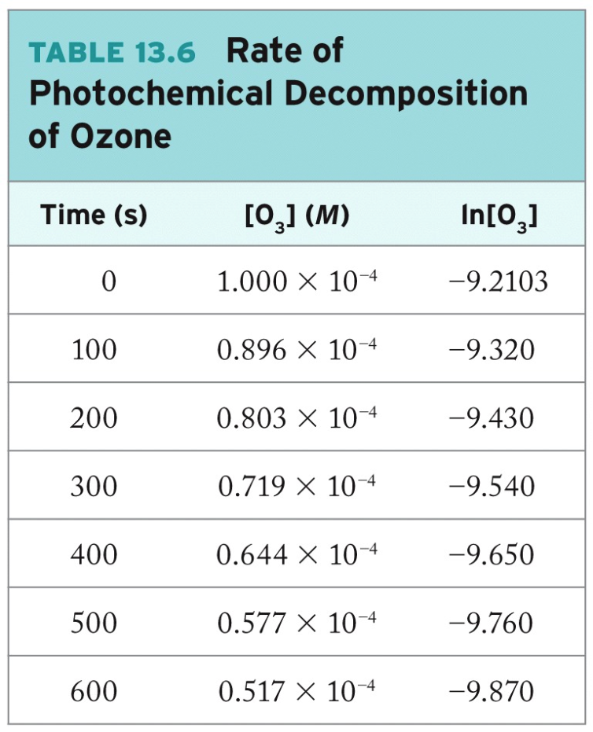
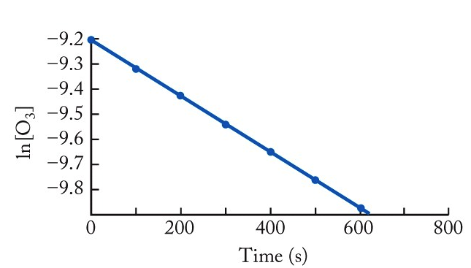
Integrated Rate Law: First Order
O₃(g) → O₂(g) + O(g)
Integrated Rate law
Rearrange expression.
ln [O₃]₀
Equation for a line
m = -k

Slide 35
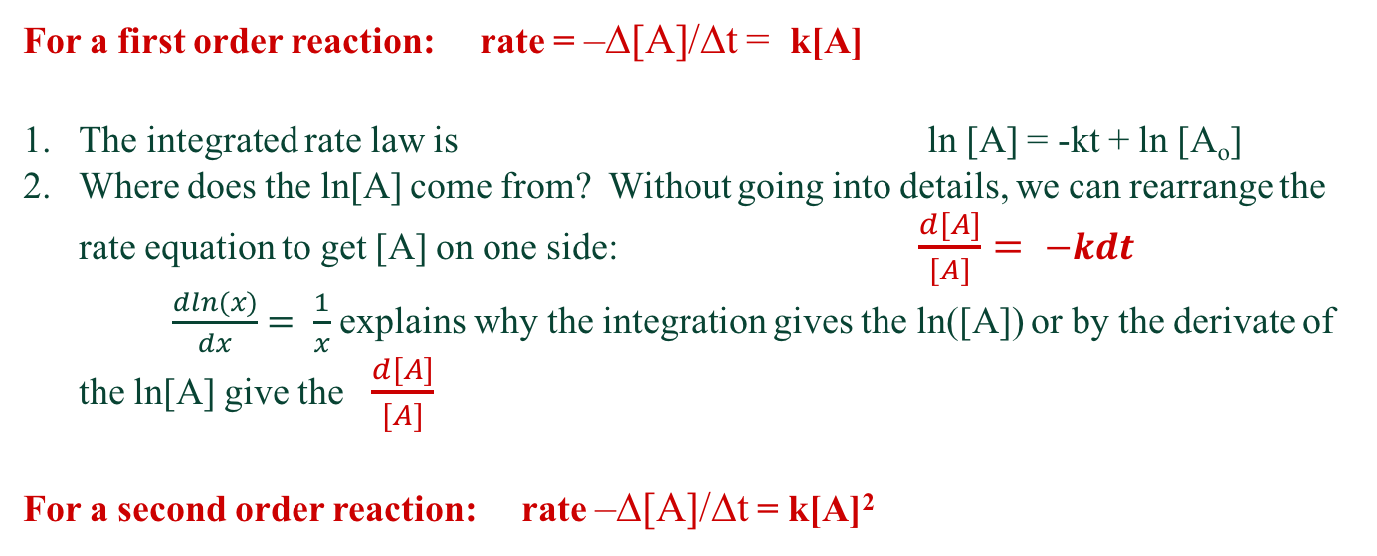
Integrated Rate Laws
Integrated rate laws: Summary with simplified calculus mnemonics
(see Pilot for full explanation of 0th, 1st, and 2nd .)
For a first order reaction: rate = –∆[A]/∆t = k[A]
The integrated rate law is ln [A] = -kt + ln [A_{o}]
Where does the ln[A] come from? Without going into details, we can rearrange the rate equation to get [A] on one side: $\frac{d[A]}{[A]}= −kdt$ $\frac{dln(x)}{dx}= \frac{1}{x}$ explains why the integration gives the ln([A]) or by the derivate of the ln[A] give the $\frac{d[A]}{[A]}$
For a second order reaction: rate –∆[A]/∆t = k[A]²

Slide 36
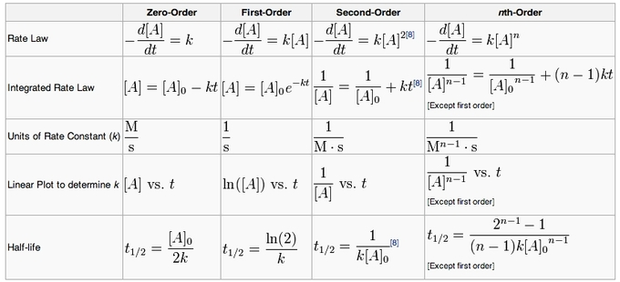
Integrated Rate Laws
Ignore nth-order
The “8” is a reference
https://courses.lumenlearning.com/boundless-chemistry/chapter/the-rate-law-concentration-and-time/

Slide 37
Example: Integrated Rate Law, First Order
Gives [A] vs t
The decomposition of hydrogen peroxide in dilute sodium hydroxide solution is described by the equation:
2H₂O₂(aq) → 2H₂O(l) + O₂(g)
The reaction is first order in H₂O₂, the rate constant for the consumption of H₂O₂ at 20 °C is 1.8×10⁻⁵ s⁻¹, and the initial concentration of H₂O₂ is 0.30 M.
(a) What is the concentration of H₂O₂ after 4.00 h?
(b) How long will it take for the H₂O₂ concentration to drop to 0.12 M?
(c) How long will it take for 90% of the H₂O₂ to decompose?
Notes:
Look at the integrated rate law and solve for what you are looking for then plug in the number (in this case use the 1st order equation because the equation tells you that)

Slide 38
Example: Integrated Rate Law, First Order
The decomposition of hydrogen peroxide in dilute sodium hydroxide solution is described by the equation:
2H₂O₂(aq) → 2H₂O(l) + O₂(g)
The reaction is first order in H₂O₂, the rate constant for the consumption of H₂O₂ at 20 °C is 1.8×10⁻⁵ s⁻¹, and the initial concentration of H₂O₂ is 0.30 M.
Based on being described as “first order”,
Rate law:
Integrated rate law for a “first order” reaction,
Integrated Rate law:

Slide 39
Example: Integrated Rate Law, First Order
2H₂O₂(aq) → 2H₂O(l) + O₂(g)
The reaction is first order in H₂O₂, the rate constant for the consumption of H₂O₂ at 20 °C is 1.8×10⁻⁵ s⁻¹, and the initial concentration of H₂O₂ is 0.30 M.
(a) What is the concentration of H₂O₂ after 4.00 h?
Need to use our integrated rate equation as it relates concentration and time.
units for k are in s⁻¹
units for t need to be in s
Plug-in values.
Using a property of logs

Slide 40
Example: Integrated Rate Law, First Order
2H₂O₂(aq) → 2H₂O(l) + O₂(g)
The reaction is first order in H₂O₂, the rate constant for the consumption of H₂O₂ at 20 °C is 1.8×10⁻⁵ s⁻¹, and the initial concentration of H₂O₂ is 0.30 M.
(b) How long will it take for the H₂O₂ concentration to drop to 0.12 M?
Need to use our integrated rate equation as it relates concentration and time.
Solve for t.
Plug-in values.

Slide 41
Practice: Integrated Rate Law, First Order
2H₂O₂(aq) → 2H₂O(l) + O₂(g)
The reaction is first order in H₂O₂, the rate constant for the consumption of H₂O₂ at 20 °C is 1.8×10⁻⁵ s⁻¹, and the initial concentration of H₂O₂ is 0.30 M.
(c) How long will it take for 90% of the H₂O₂ to decompose?
Need to use our integrated rate equation as it relates concentration and time.
Recognize: 90% decomposition = 10% remains
Plug-in values.

Slide 42
Half-Life: First Order Reactions
Half-Life (t_{1/2}):
The time in the course of a chemical reaction during which the concentration of a reactant decreases by half
First Order Integrated Rate Law
Half-Life definition:
Substitute

Slide 43
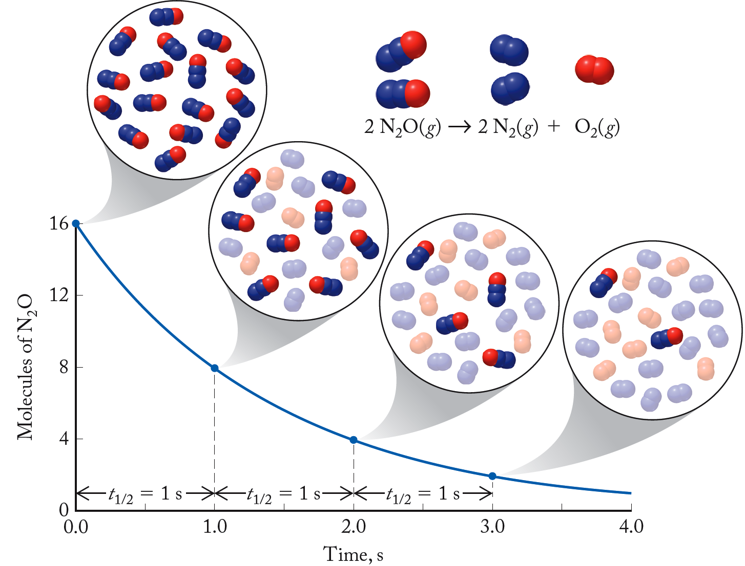
Half-Life: First Order Reactions
t_{1/2} (1) = t_{1/2} (2) = t_{1/2} (3)
1
2
Independent of concentration
3

Slide 44
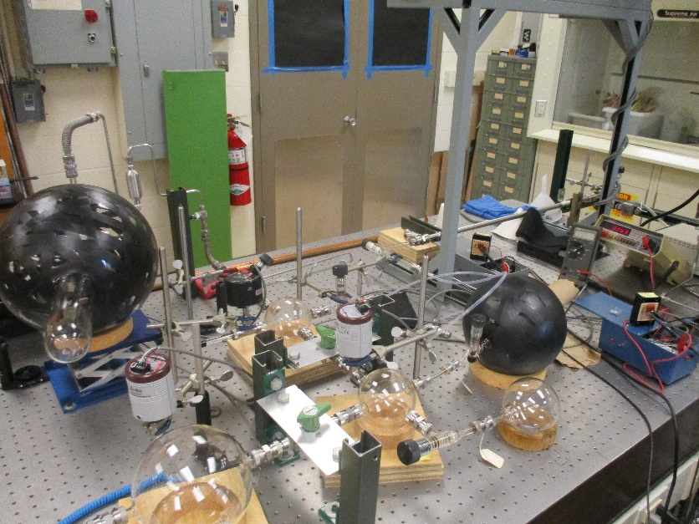
Chemical Kinetics Research (Dolson lab)
Joel Schmitz (MS’17) and Clément Blanchard (IUT Lannion, France)
Experimental determination of the rate coefficients for nitrosyl bromide formation (of atmospheric interest).
Relaxation kinetics method: A system at equilibrium is perturbed by expansion into a larger volume (reduces partial pressures) or by photolysis (converts BrNO into NO and Br₂). Rate coefficients are determined from the rate of approach to a new equilibrium state (volume expansion) or from the rate of return to the original equilibrium (photolysis perturbation). LeChatlier’s principle applies.
0.5 L reaction flask
2 L expansion flask
NO
Br₂
pressure gauges

Slide 45
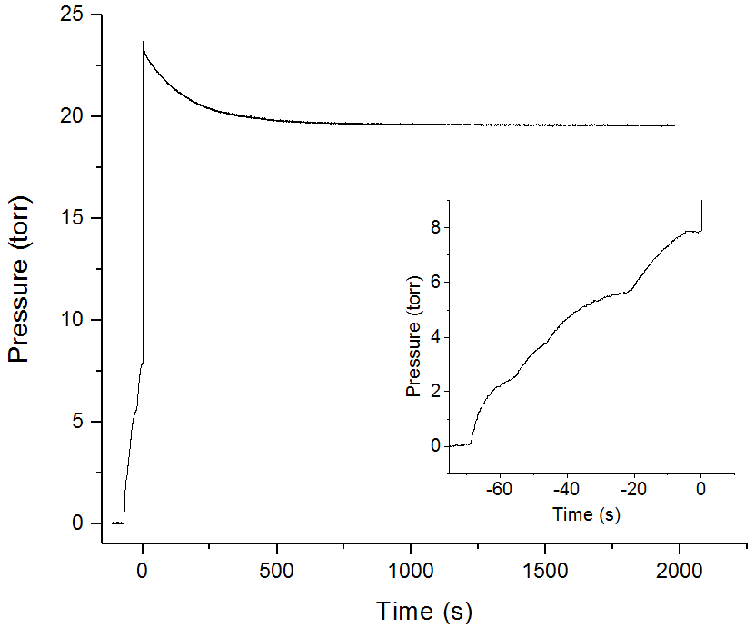
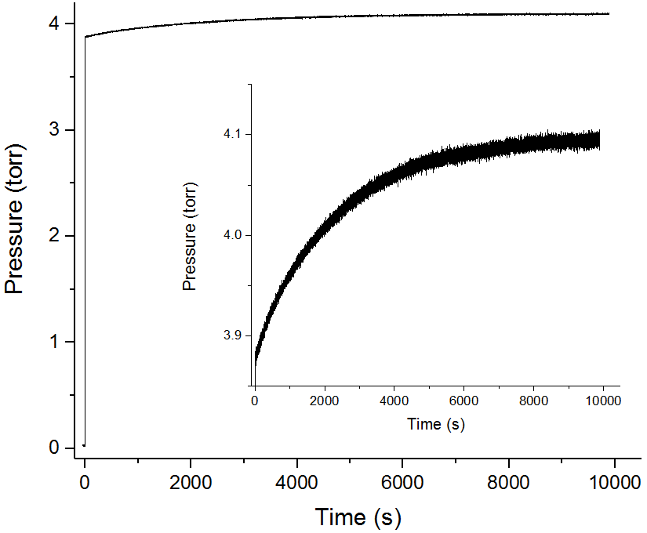
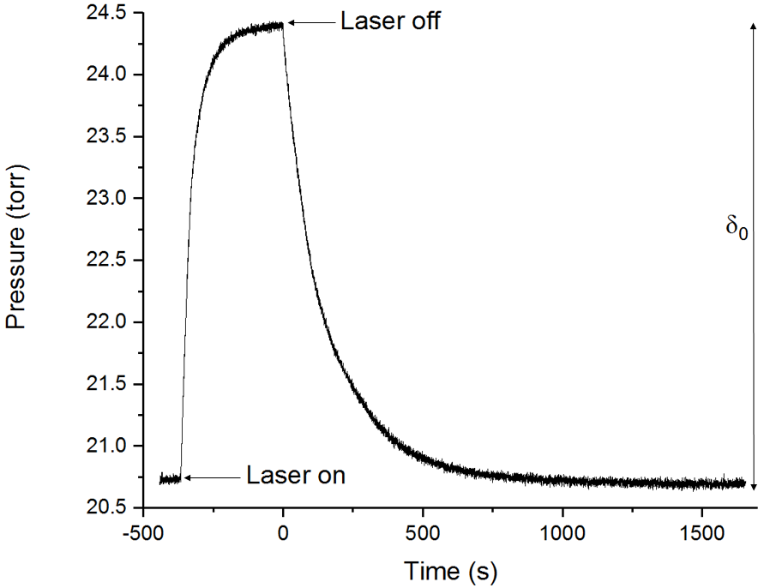
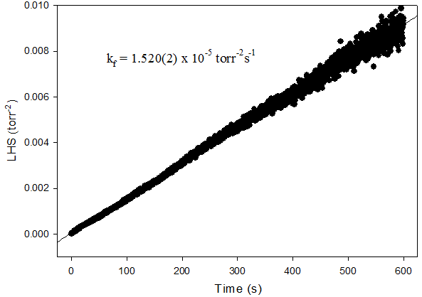
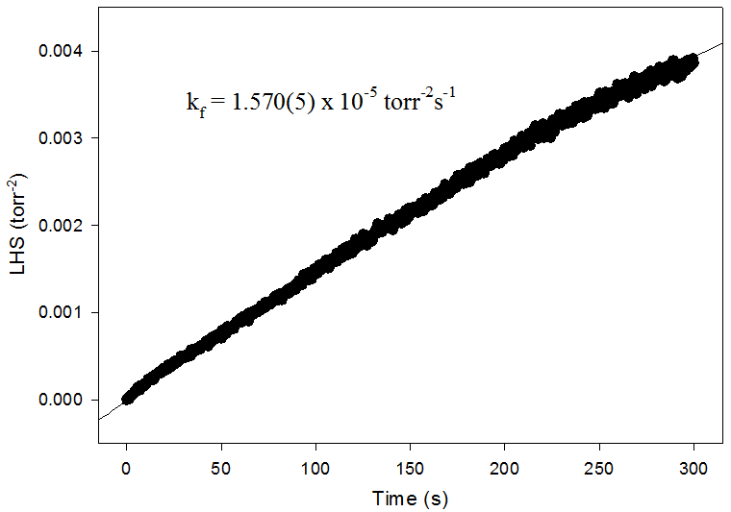
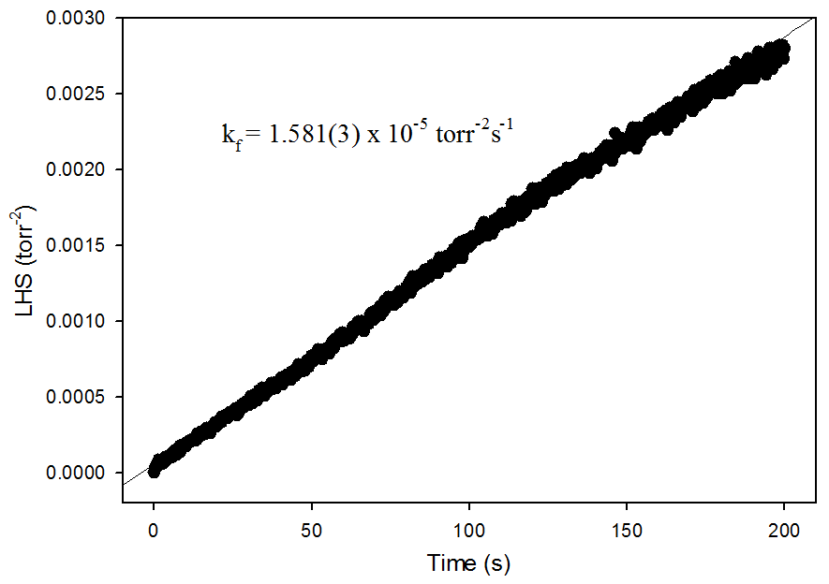
Chemical Kinetics Research (Dolson lab)
Joel Schmitz (MS’17) and Clement Blanchard (IUT Lannion, France)
For each type of reaction studied (formation, expansion or photolysis) we have derived the mathematical integrated rate law, and plotted its left hand side (LHS) on the y-axis vs. time on the x-axis, and find k_{f} from the slope. k_{r} = k_{f}/K_{eq}.
formation reaction
expansion perturbation
photolysis perturbation

Slide 46
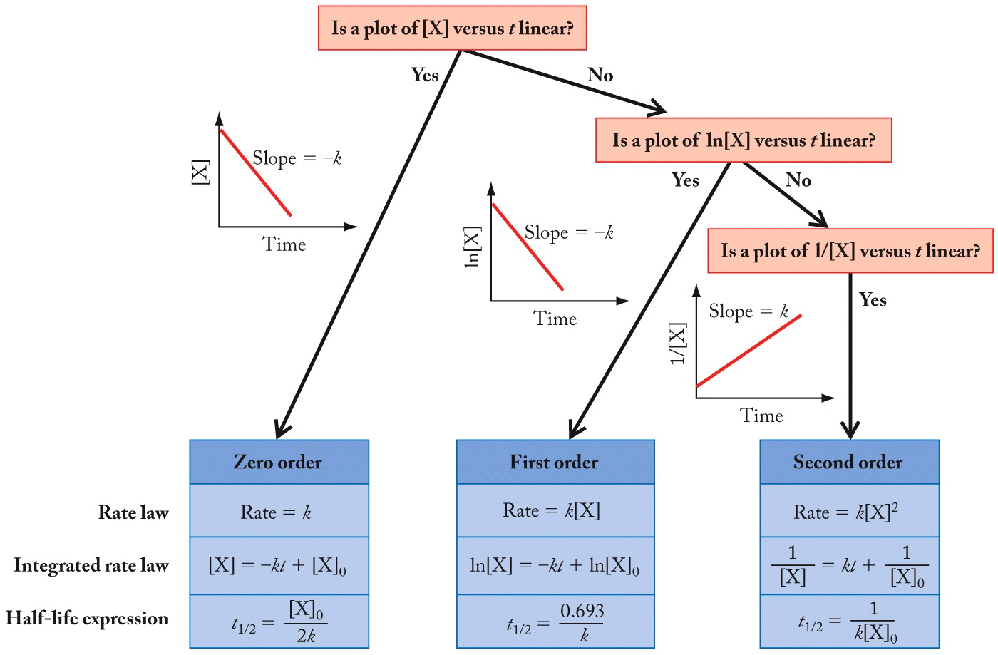
Integrated Rate Laws

Slide 47
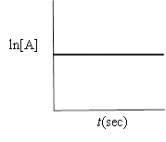
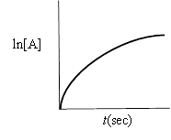

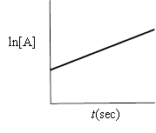
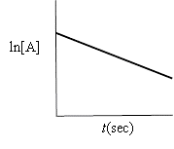
Indicate which of the following plots would be obtained for a first-order reaction.
Practice: Integrated Rate Laws
A.
C.
E.
none of these
B.
D.

Slide 48
Example: First Order Kinetics
The radioactive isotope ³²P decays by first-order kinetics and has a half-life of 14.3 days. How long does it take for 95.0% of a sample of ³²P to decay?
³²P decays via first order kinetics, so:
Now can calculate time for 95% decay:
Remember: 95% decay = 5% remains
Half-Life definition:
Substitute and solve for t:
Solve for k:
Notes:
Next few steps I generally know that [x]=0.5[x]initial then substatute

Slide 49
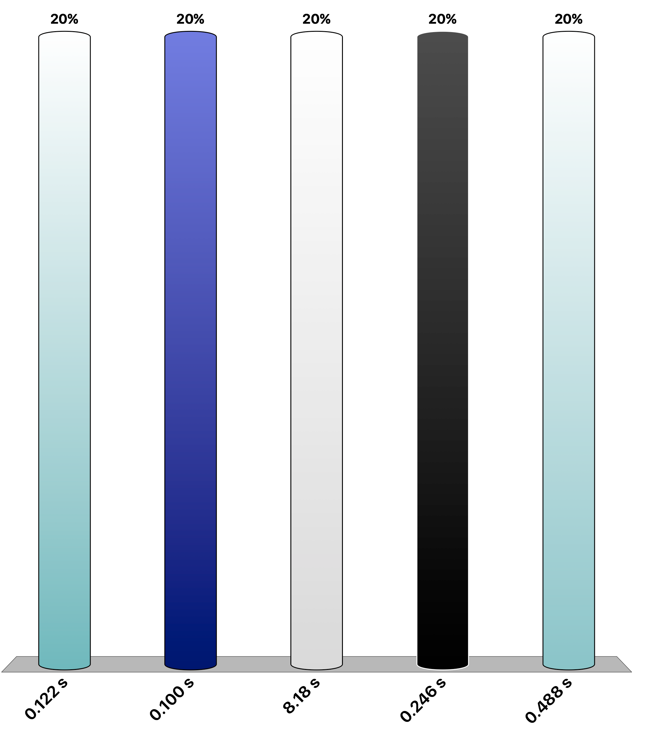
The first-order reaction A → B has k = 5.67 s⁻¹. If [A]₀ = 0.500 M, how long will it take [A] = 0.124 M? Note that because it’s asking for [A] not ∆[A] we need to use the integrated rate law which is [A] vs t
Your Turn (TopHat): Integrated Rate Law
TopHat numerical answer

Slide 50
Integrated Rate Law: Second Order
2NO₂(g) → 2NO(g) + O₂(g)
Example:
Rate law:
(Experimentally determined)
Can write an integrated rate law which relates concentration to time
Integrated Rate law:
Calculus is utilized to derive this expression
Only applicable to reactions second order in a single reactant.
Second Order Integrated Rate Law

Slide 51
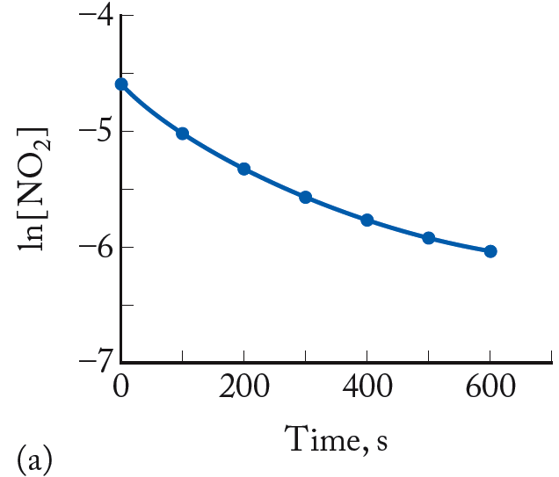
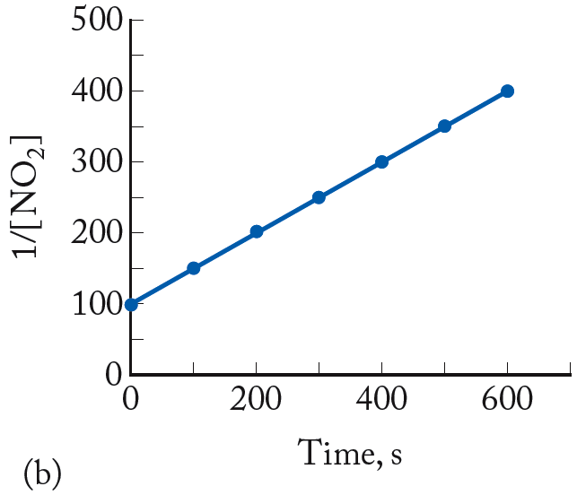
Integrated Rate Law: Second Order Reactions
2NO₂(g) → 2NO(g) + O₂(g)
Integrated Rate law
Equation for a line
m = k
linear
curved
1/[NO₂]₀
Not first order, as
ln [NO₂] vs. t is not linear
Second order,
1/[NO₂] vs. t is linear

Slide 52
Half-Life: Second Order Reactions
Second Order Integrated Rate Law
Half-Life definition:
Substitute

Slide 53
Integrated Rate Law: Zeroth Order
Zeroth-Order Rate Law:
Rate of reaction is independent of concentration
Example:
2C₂H₅OH(g) → C₂H₄(g) + 3H₂O(g)
Rate law:
Can write an integrated rate law which relates concentration to time
Integrated Rate law:
Calculus is utilized to derive this expression
Zeroth-Order Integrated Rate Law

Slide 54
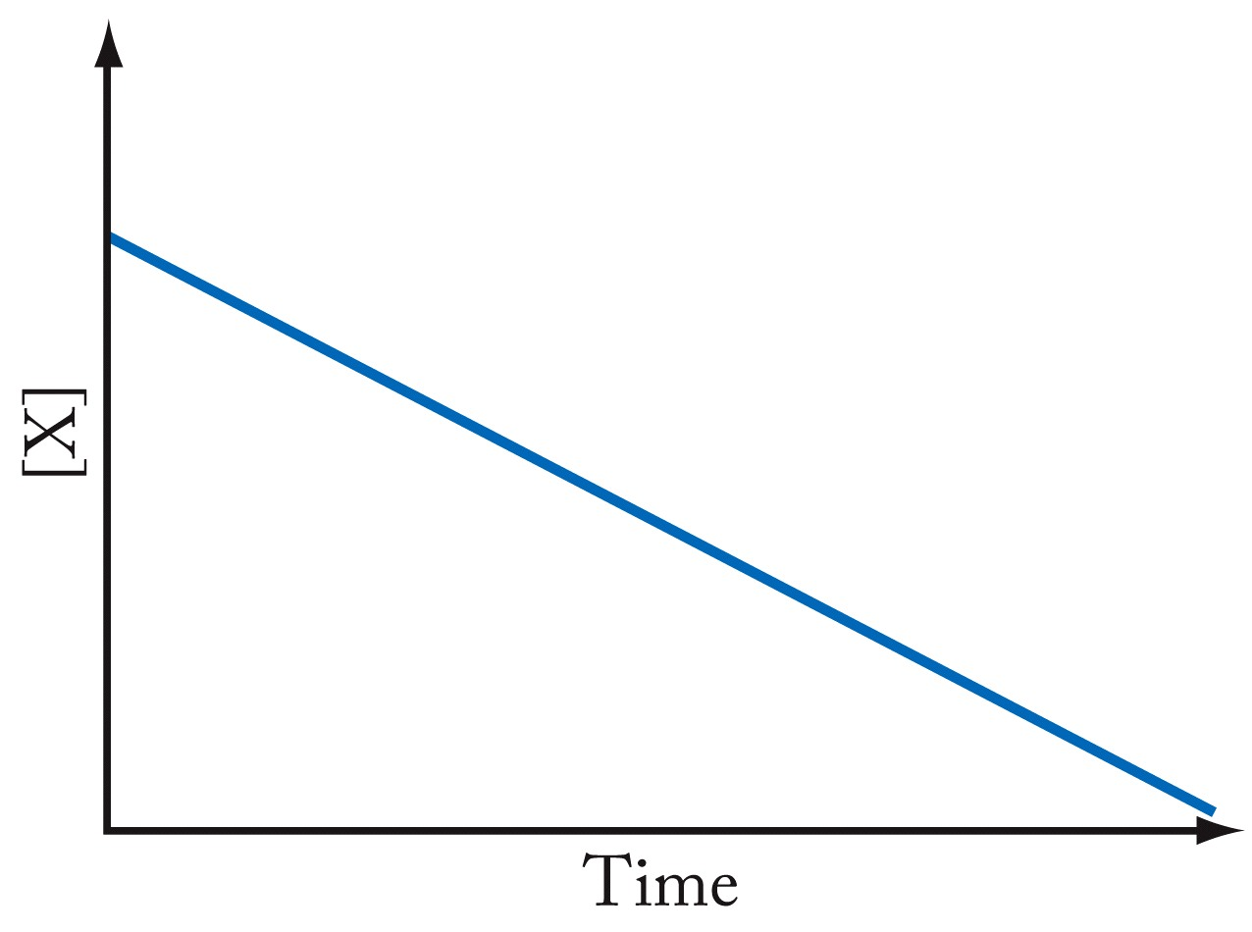
Integrated Rate Law: Zeroth Order
Integrated Rate law
Equation for a line
[X]₀
m = -k
linear

Slide 55
Half-Life: Zeroth-Order Reactions
Zeroth-Order Integrated Rate Law
Half-Life definition:
Substitute

Slide 56
Example: Zero-Order Reactions
The rate constant for the zeroth-order decomposition of NH₃ on a platinum surface at 856 ºC is 1.50×10⁻⁶ M/s. If the initial concentration of NH₃ is 1.50×10⁻² M, calculate the concentration of NH₃ after 30 minutes.
Based on being described as “zeroth order”,
Rate law:
Integrated Rate law:
Plug-in values:

Slide 57
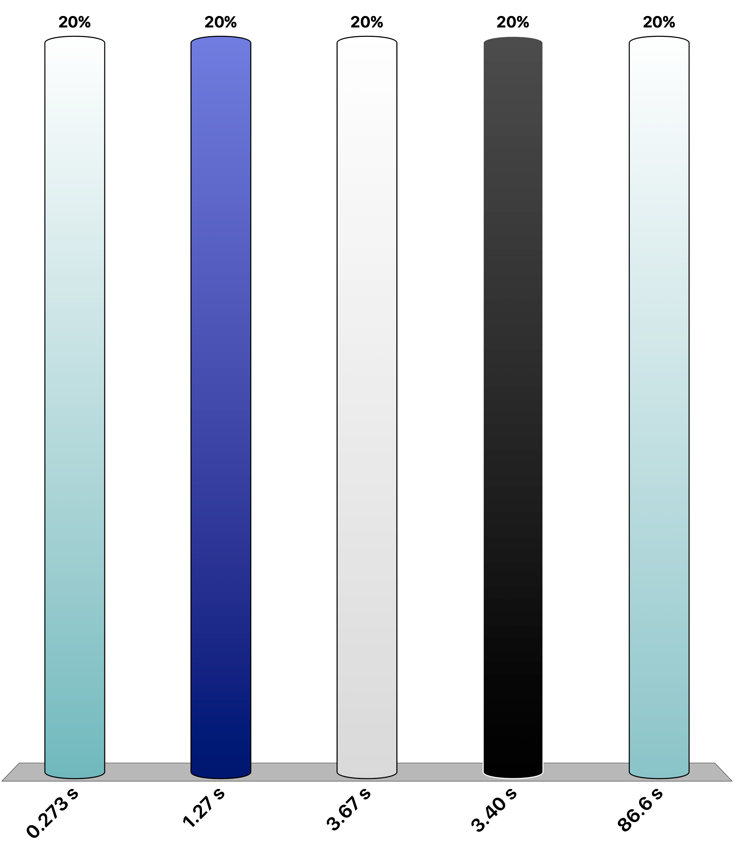
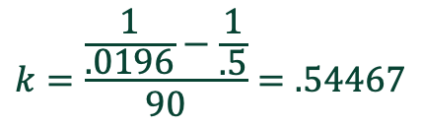
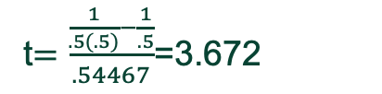
Nitrogen dioxide undergoes thermal decomposition according to the second-order reaction: 2NO₂(g) → 2NO(g) + O₂(g) When 0.500 M NO₂ is allowed to react for 90.0 s, its concentration falls to 0.0196 M. What is the half-life of the reaction when [NO₂]₀ = 0.500 M? (time in sec.)
Your Turn (TopHat): Integrated Rate Laws
$$k=\frac{\frac{1}{.0196}−\frac{1}{.5}}{90}=.54467$$
t$=\frac{\frac{1}{.5(.5)}−\frac{1}{.5}}{.54467}$=3.672
Notes:
Solve for k then set the concentration to the concentration for a half life then solve for t

Slide 58
Other Reaction Orders
Pseudo-First-Order:
All reactants, but one, are present at such high concentrations that they do not decrease significantly during the course of reaction
Reaction rate is controlled by the concentration of the limiting reactant
NO(g) + O₃(g) → 2NO₂(g) + O₂(g)
Example:
Actual Rate law:
First order with respect to BOTH [NO] & [O₃]
However, if [O₃] >> [NO], and [O₃] essentially remains unchanged,
Pseudo Rate law:
Where, kʹ = k[O₃]₀
Reaction rate behaves like that of a first order reaction.
Notes:
Just add a ton of other reactants so the rate is functionally dependent on only one reactant

Slide 59
Factors Affecting Rate
Temperature:
Increased temperature increases kinetic energy of molecules, molecular collisions
Activation Energy (E_{a}):
Minimum energy of molecular collisions required to break bonds in reactants, leading to formation of products
These factors are incorporated into rate constant k by the Arrhenius equation
Rate = k[A]^{m}[B]^{n}

Slide 60
Arrhenius Equation
Pay attention here to units!
E_{a} = activation energy (kJ/mol, or J/mol)
R = universal gas constant (in J/mol·K)
T = temperature (in kelvin)
A is a collisional frequency factor
Includes frequency of collisions and an orientation factor
Log form:
y = m • x + C
Notes:
Log form is given

Slide 61
Frequency Factor
Frequency Factor (A):
Product of molecular collisions and a factor that expresses the probability that the orientation of the molecules is appropriate for reaction
This has its underpinnings in statistical mechanics, which we won’t delve into.
Notes:
Remember to convert units, activation energy is usually in kJ but the R constant is in J/(mol*K)

Slide 62
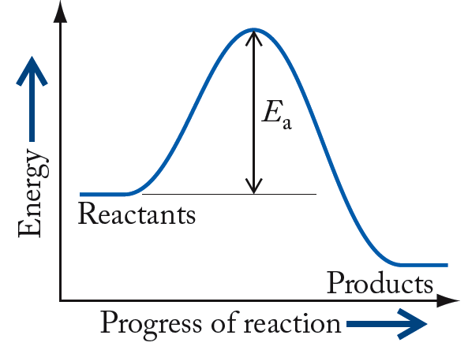
Reaction Energy Profile
High-energy “transition state” or “activated complex”
energy barrier
Activation
energy (E_{a})
Also note, based on relative energies you can say this reaction is exothermic!
Notes:
Products having higher energy = endothermic
Products having lower energy = exothermic

Slide 63
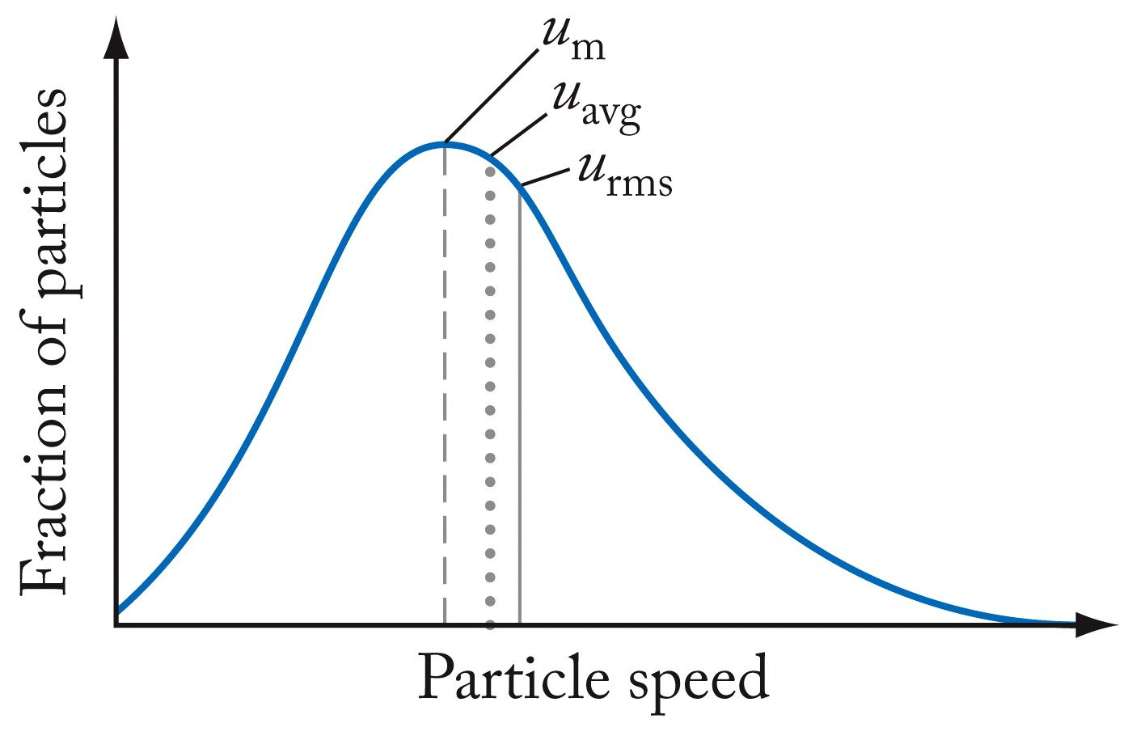
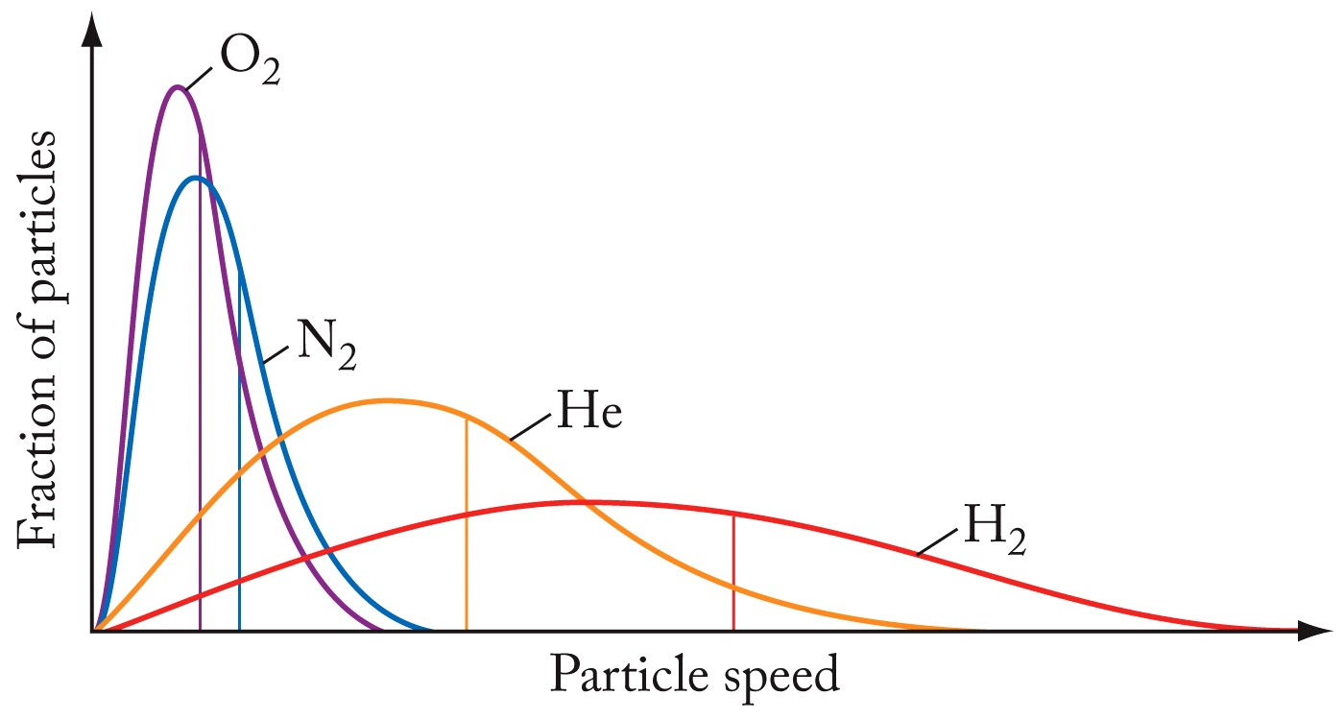
Review: Kinetic Molecular Theory (KMT)
How best to represent the kinetic energy of a collection of gas particles?
u_{m} is the most probable speed
u_{avg} average speed
u_{rms} is root-mean-square speed
Average Kinetic Energy:
u_{rms} = the root-mean-squared speed of the molecules; m = molecular mass.

Slide 64
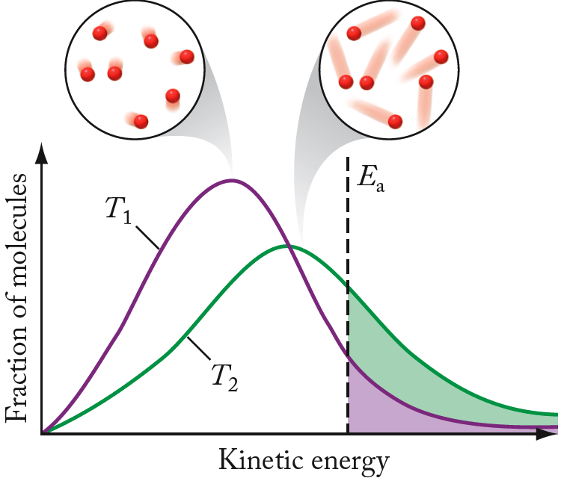
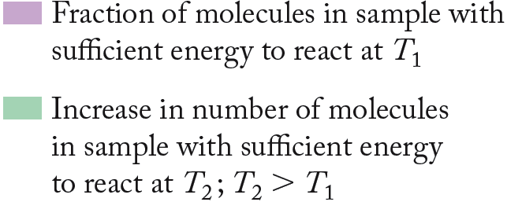
Effect of Temperature
Increasing temperature helps more molecules overcome energy barrier.

Slide 65
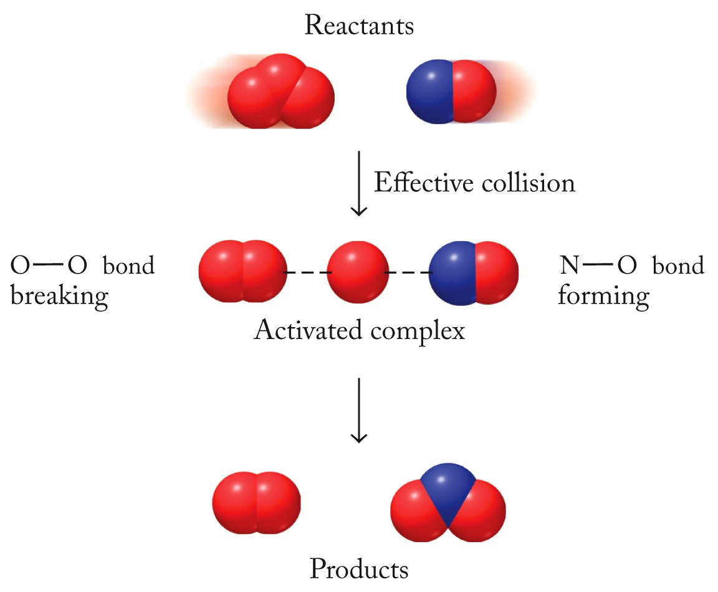
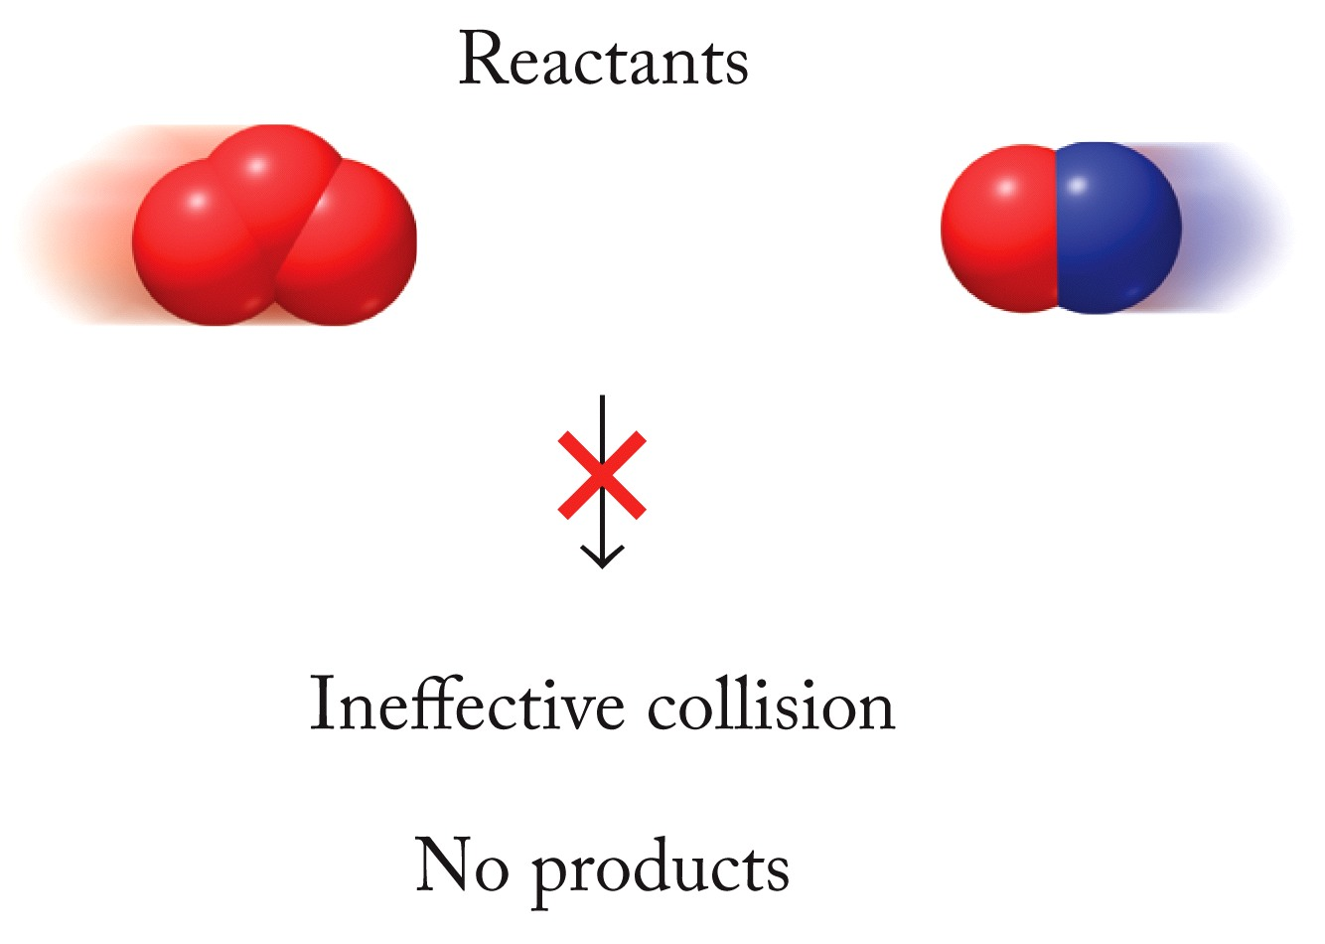
Molecular Orientation
O₃(g) + NO(g) → O₂(g) + NO₂(g)
Only molecules that collide in the proper orientation will react. (This is more obvious with complicated molecules.)
Notes:
A bond breaking is usually accompanied by a bond forming at the same time unless there is an intermediate (elementary) step between the bond breaking and the bond forming

Slide 66
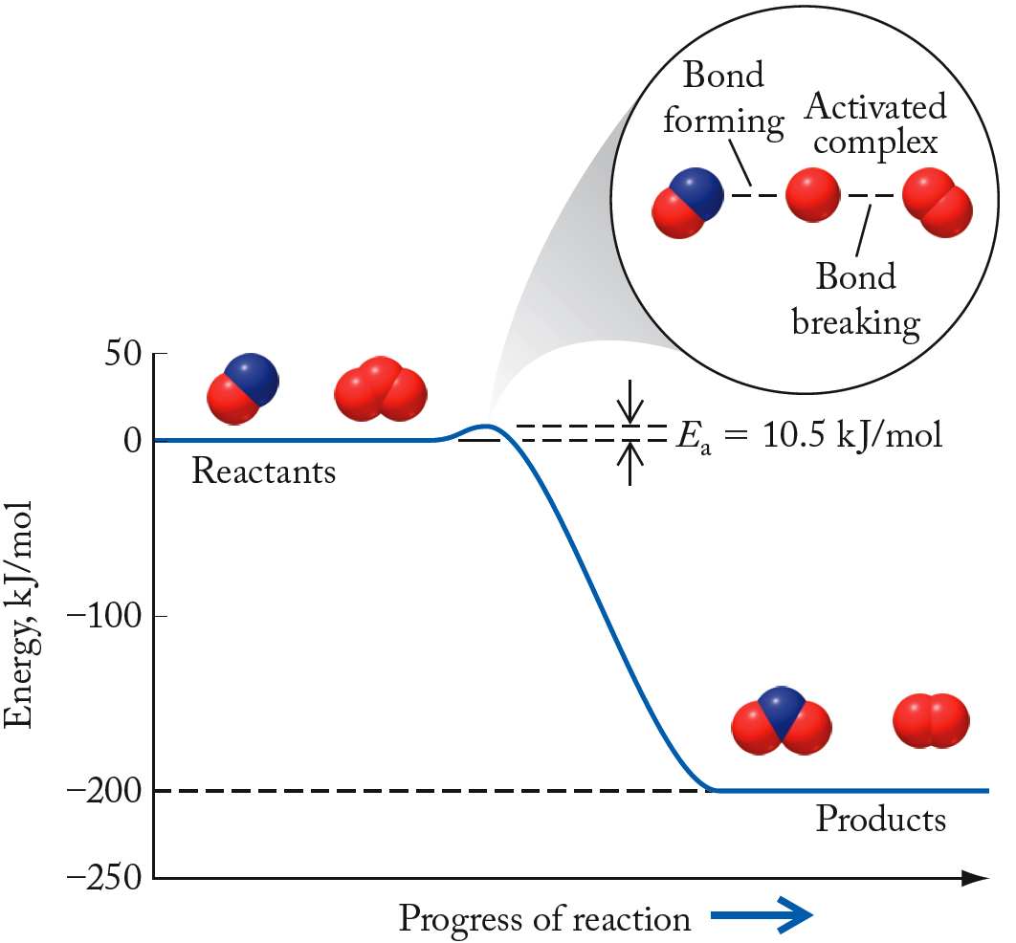
Energy Profiles
O₃(g) + NO(g) → O₂(g) + NO₂(g)
Low E_{a} = large k, fast forward reaction
Transition-state
A low barrier means more molecules can get over it and the reaction will be “fast”
Practical application of Arrhenius Equation

Slide 67
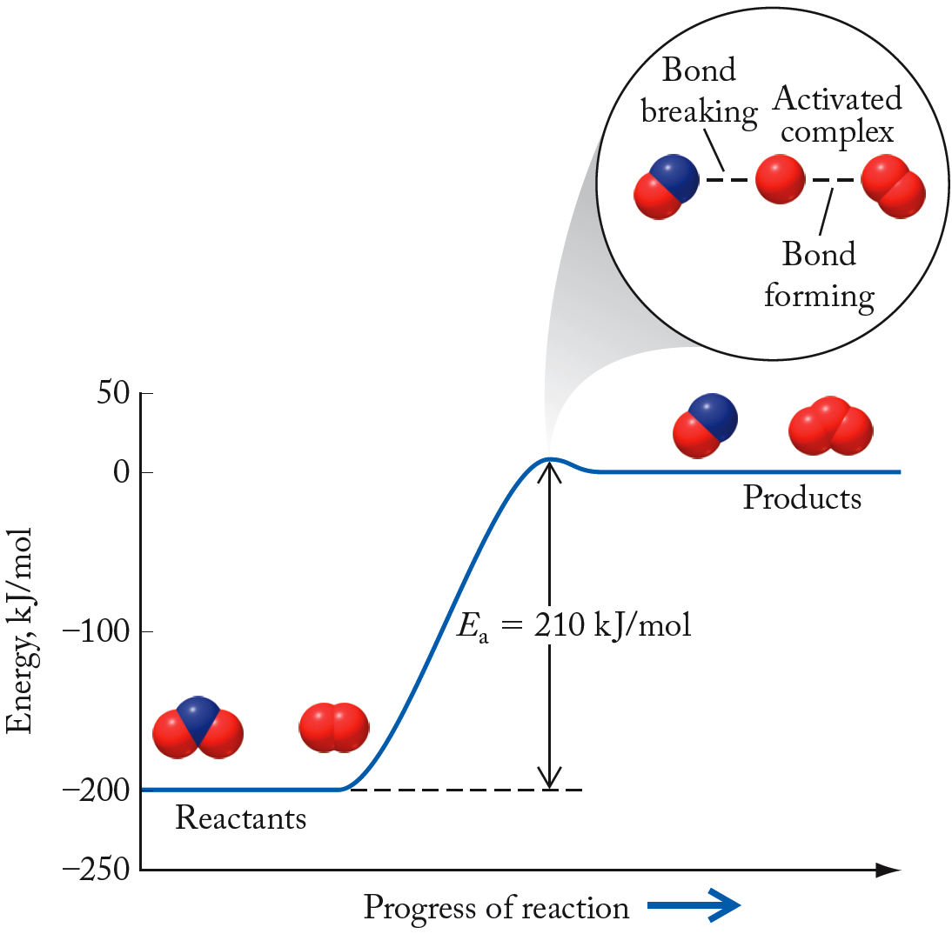
Energy Profiles
O₃(g) + NO(g) ← O₂(g) + NO₂(g)
note that we have “reversed” the reaction
High E_{a} = small k, slow reverse reaction
Transition-state
A high barrier means most molecules will not have enough energy to react, and the reaction will be slow.
Practical application of Arrhenius Equation

Slide 68
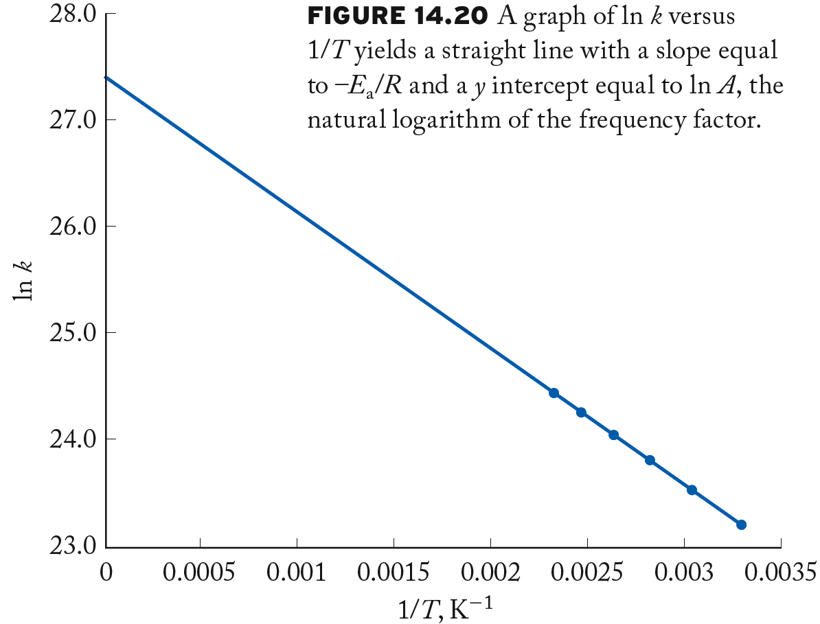
Graphical Determination of E_{a}
Take ln of both sides
ln A
Rearrange
Equation for a line
m = -E_{a}/R
linear

Slide 69
Mathematical Determination of E_{a}
Consider determination of k at two different temperatures:
Combine two equations through subtraction:
Can calculate activation energy when given rate constants at two different temperatures

Slide 70
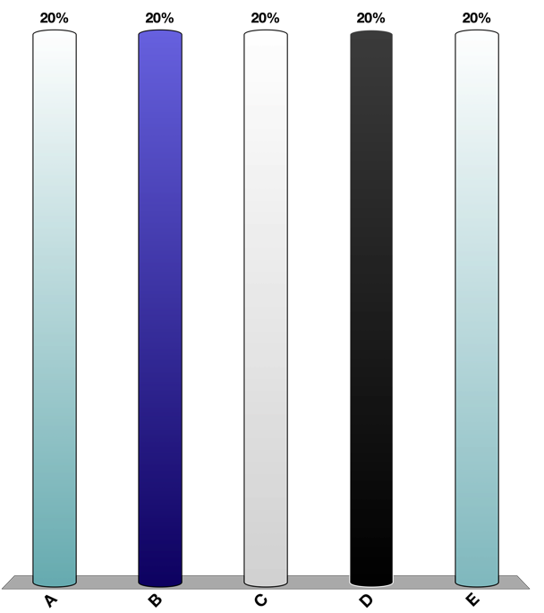
Given the following data for the reaction A → B, determine the activation energy, E_{a}, of the reaction.
Practice: Arrhenius Equation
k (s⁻¹) | T (K)
2.04 × 10^{–4} | 250.0
6.78 × 10^{–3} | 400.0
k₁ =
= T₁
Doesn’t matter which you set as 1 or 2 (just the proper pairing)
k₂ =
= T₂
Use the Arrhenius equation comparing rate constants at two temperatures
Solve for activation energy, E_{a} & plug-in values
Make sure to pay attention to units, so that they cancel properly.

Slide 71

Reaction Mechanisms
NO₂(g) + CO(g) → NO(g) + CO₂(g)
Experimental evidence suggests that the reaction between NO₂ and CO doesn’t occur via a single collision but rather through a series of two elementary reactions:
Intermediate
NO₂(g) + NO₂(g) → NO(g) + NO₃(g)
elementary reaction
(intermediate steps)
NO₃(g) + CO(g) → NO₂(g) + CO₂(g)
elementary reaction
NO₂(g) + CO(g) → NO(g) + CO₂(g)
overall reaction
Reaction Mechanism: A set of steps that describe how a reaction occurs at the molecular level; must be consistent with the rate law for the reaction

Slide 72
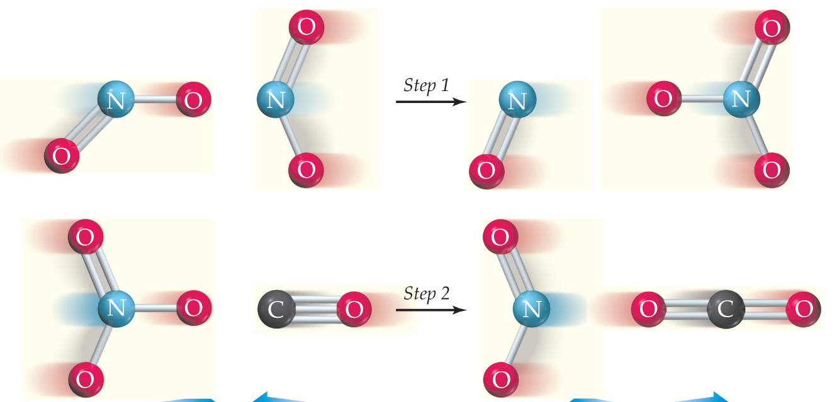
Reaction Mechanisms
Elementary
Step 1
(bimolecular)
Intermediate
Elementary
Step 2
(bimolecular)
Intermediate
Elementary Step: Molecular-level view of a single process taking place in a chemical reaction
Intermediate: Species produced in one step of a reaction and consumed in a subsequent step
Molecularity: Number of ions, atoms, or molecules involved in an elementary step in a reaction

Slide 73

Rate Laws for Elementary Reactions
Remember: the balanced chemical equation does not tell us anything about the overall rate law for a reaction.
However, for an elementary step the stoichiometric coefficients do describe the overall rate law.
This a result of the fact that we are literally describing the molecular-level collisions occurring when writing equations of elementary steps.
Notes:
$$\sum{coefficients≠rate law for a reaction}$$
$$\sum{coefficients=rate law for an elementary step}$$

Slide 74
Reaction Mechanisms
NO₂(g) + CO(g) → NO(g) + CO₂(g)
elementary step 1
NO₂(g) + NO₂(g) → NO(g) + NO₃(g)
Can write a rate law directly from balanced chemical equation.
elementary step 2
NO₃(g) + CO(g) → NO₂(g) + CO₂(g)
Can write a rate law directly from balanced chemical equation.
overall reaction
NO₂(g) + CO(g) → NO(g) + CO₂(g)
Experimentally determined

Slide 75
Rate-Determining Step
Rate-determining step: The slowest step in a multistep reaction, determines the overall rate of reaction
(It acts as a bottleneck and limits the rate at which reactants can be converted to products.)
NO₂(g) + CO(g) → NO(g) + CO₂(g)
NO₂(g) + NO₂(g) → NO(g) + NO₃(g)
slow
NO₃(g) + CO(g) → NO₂(g) + CO₂(g)
fast
NO₂(g) + CO(g) → NO(g) + CO₂(g)
Step 1 slower than Step 2, thus rate-determining step. The overall reaction is zeroth-order with respect to [CO] as not involved in RDS.

Slide 76

Predicting Reaction Mechanism
This a procedure so many chemists go through in research to understand the chemical reactions they are performing.
As with much about reaction rates, reaction mechanisms can’t be proved on paper, experimental data has to be collected.

Slide 77
Summary of our process.
We will be given a proposed mechanism. (coming up with our own is beyond this course)
Determine the rate determining step: (We will only have two choices)
The first step is the Rate Determining Step
The second step is Rate Determining Step
Eliminate any intermediates because they can not end up in the overall rate law.
Compare the rate law from the mechanism with the rate law measured by experiment (many forget this in the JAR)

Slide 78

Example: Proposing a Mechanism
2NO(g) + O₂(g) → 2NO₂(g)
Observed rate law: Rate = k[NO]²[O₂]
What is a potential reaction mechanism?
Step 1:
NO + O₂ $⇌$ NO₃
Rate₁ = k₁[NO][O₂]
fast & reversible
Step 2:
NO₃ + NO → 2NO₂
Rate₂ = k₂[NO₃][NO]
slow
Consider the possibilities here for rate-determining step. Can these steps achieve the observed rate law for the overall reaction?
If Step 2 is the rate determining step and Step 1 is fast and reversible.

Slide 79

Example: Proposing a Mechanism
Step 1:
NO + O₂ $⇌$ NO₃
Rate₁ = k₁[NO][O₂]
fast & reversible
Step 2:
NO₃ + NO → 2NO₂
Rate₂ = k₂[NO₃][NO]
slow
If Step 2 is rate determining step and Step 1 is fast & reversible.
NO + O₂ → NO₃
Rate₁ = k₁[NO][O₂]
fast
NO₃ → NO + O₂
Rate₋₁ = k₋₁[NO₃]
fast
Reversible = rates for the forward reaction and the backward reaction are the same (definition of equilibrium)
Solve for [NO₃]:
Substitute

Slide 80
Example: Proposing a Mechanism
Step 1:
NO + O₂ $⇌$ NO₃
Rate₁ = k₁[NO][O₂]
fast & reversible
Step 2:
NO₃ + NO → 2NO₂
Rate₂ = k₂[NO₃][NO]
slow
Solve for [NO₃]:
Plug into rate law from rate-determining step.
Plausible…but need to experimentally verify RDS step, intermediates, etc.
Rate law of rate-determining step will be the overall rate law

Slide 81

Multi-step Reaction Energy Profiles
2NO₂ (g) → 2NO(g) + O₂(g)
Step 1 has a high activation energy barrier, meaning it is slow.
Transition state #1
Step 2 has a lower activation energy barrier, meaning it is fast
Transition state #2
RDS!
If provided an energy profile of a multistep reaction, can determine RDS!
2NO₂ → NO₃
+ NO → 2NO + O₂
elementary step 1
elementary step 2
Notes:
Ea is the slow step because it takes so much activation energy to start
Be able to interpret this

Slide 82
Catalysts
Catalyst: A substance added to a reaction that increases the rate of the reaction but is not consumed in the process
Generally changes reaction mechanism, permitting faster rates
Often used to allow reactions to run faster at lower temperatures
Enzymes are catalysts for biochemical reactions
Fundamentally, catalysts lower the activation energy barrier for a reaction.

Slide 83

Example: Catalysts
Overall:
2H₂O₂(aq) → H₂O(l) + O₂(aq)
rate-determining step
Step 1:
H₂O₂(aq) + I⁻(aq) → H₂O(l) + IO⁻(aq)
catalyst
fast step
Step 2:
H₂O₂(aq) + IO⁻(aq) → H₂O(l) + O₂(g) + I⁻(aq)
catalyst
With catalyst
Without catalyst
large energy barrier
lower energy barrier

